Slide 1


SWP391 Final Presentation
Bloodline DNA Testing Service Management System
Supervisor
Lại Đức Hùng
Team 3 – SE1843
Võ Minh Ý - SE182099 (Leader)
Trần Võ Quang Duy - SE182146
Lý Gia Huy - SE182103
Trần Hải Đăng - SE181926

Slide 2

Table Of Contents
Project introduction
System architectural overview
Features
Demonstration
Outcomes
Q&A

Slide 3
1. Project Introduction | Context & Problems
Problems:
Lack of clear and transparent service information
Offline registration is time-consuming
No way to track test progress or receive results online
No customer feedback or rating system

Slide 4
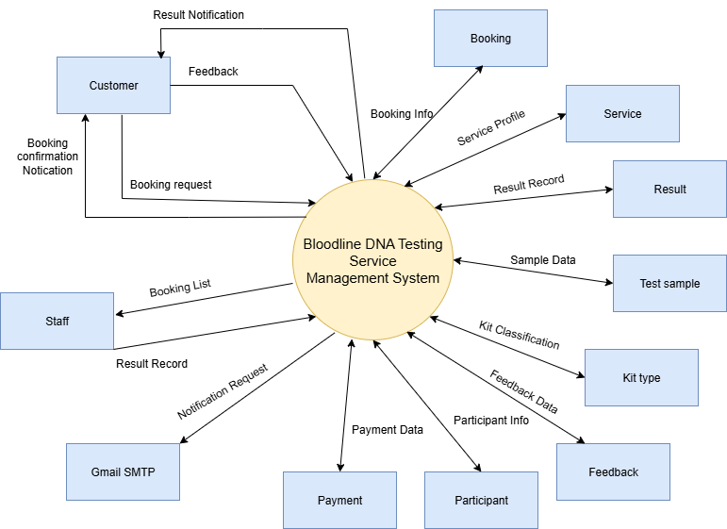
1. Project Introduction | Solutions

Slide 5
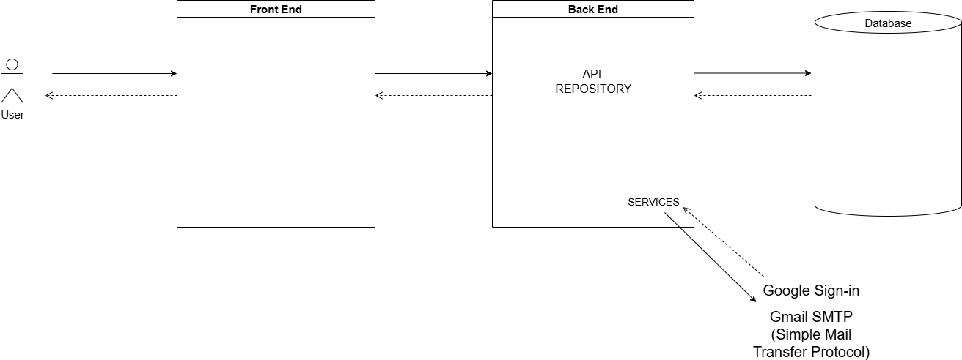






2. System Architectural Overview
Tech stacks
Back-end:
Spring Boot
Maven
JPA/Hibernate
Front-end:
HTML, CSS, JavaScript
Thymleaf template
Database:
Microsoft SQL Server

Slide 6



3. Actor & Feature
Admin
Guest
Customer
👥 Manage users
🧬 Manage DNA services
📊 Dashboard & analytics
💰 Pricing & promotions
⚙️ System settings
🔍 Browse services
📧 Send inquiry
📖 Read DNA knowledge
📅 Book appointment
📞 Contact support
🔐 Register account
📦 Manage bookings
📈 Track test status
👨‍👩‍👧‍👦 Add participants
👤 Profile management
⭐ Feedback & ratings
📄 View test results
🔔 Email notifications
💳 Payment & receipts

Slide 7


3. Actor & Feature
Staff
Manager
📋 Manage appointments
📦 Kit management
🧪 Sample collection
📊 Upload test results
✅ Verify payments
📧 Send notifications
📈 View dashboard
💰 Payment oversight
📊 Generate reports
👀 Monitor operations

Slide 8




4. Demonstrate
a. At Testing Facility
Scenario #1: Customer books appointments at testing facility.
Open web
and login
Fill form of Booking
Create Booking
Customer
Bloodline DNA Testing Service Management System
Form Of Booking

Slide 9





4. Demonstrate
a. At Testing Facility
Scenario #2: Staff processes the appointment and returns test result at the testing facility.
Login to center
Check-in appointment
Check Payment
Staff
Bloodline DNA Testing Service Management System
Handles appointment
Return test result

Slide 10
4. Demonstrate
b. At Testing Home
Scenario #1: Customer books appointments at home.
Open web
and login
Fill form of Booking
Create Booking
Customer
Bloodline DNA Testing Service Management System
Form Of Booking

Slide 11



4. Demonstrate
b. At Testing Home
Scenario #2: Staff processes the appointment at home and returns test result.
Login to center
Check appointment
Send Kit
Staff
Bloodline DNA Testing Service Management System
Receive Sample
Return test result
Check Payment
Handles appointment

Slide 12
5. Outcomes
Lesson Learned
Teamwork
Time management
SDLC
Project management
Application Achievement
A platform support for:
Customer: Easy appointment booking, online results access, service tracking
Staff: Efficient booking management, test processing, result input & customer care

Slide 13
5. Outcomes
Project Deliverable
Source code: https://github.com/HuyDev123/SWP391_Team-5.git
Limitation
Multiple gateway (not yet) (COD, Transfer Manually Only)
Mutiple language (not yet)

Slide 14
Thank you for your attention Q & A

